Slide 1
Superstore Sales Analysis
An Internship Project
@InnoByte Service
Name: Nidhi Niwane
@InnoByte Service

Slide 2
Introduction
The Superstore Data Analysis Project focuses on extracting insights from a retail superstore dataset.
The dataset contains information about sales, customers, products, and orders from a fictional retail superstore.
By analyzing this data, we aim to uncover trends, patterns, and insights that can be used to improve business operations and decision-making.
@InnoByte Service

Slide 3
Project Objectives
Analyze retail sales data to derive insights into customer behavior, popular products, and sales trends. Below are the key points of project:
Data Exploration: We will begin by exploring the dataset to understand its structure and contents.
Data Cleaning: We will clean and preprocess the data to ensure its quality and suitability for analysis.
Data Analysis: We will perform in-depth analysis on various aspects of the data, such as sales trends, customer behavior, and product performance.
Data Visualization: We will create visualizations to illustrate our findings and make it easier to interpret the data.
Insights and Recommendations: Based on our analysis, we will derive insights and offer recommendations for improving business strategies.
@InnoByte Service

Slide 4
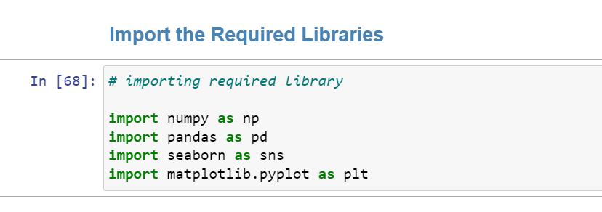
libraries & Tools
Below are the tools & libraries used for Superstore Sale Data Analysis project:
Python 3.11.5
Jupyter Notebook
Pandas
Matplotlib
Seaborn
NumPy
@InnoByte Service

Slide 5
About the Data
Dataset: Superstore Sales Dataset
Here are the definitions for a few of the columns:
Ship Mode: Mode of shipment used for shipment delivery.
Segment: Customer segment where product was shipped to.
Country: Country in which the shipment was delivered.
City: City in which shipment was delivered.
State: State in which shipment was delivered.
Postal Code: Postal code the shipment was delivered to.
Region: Country region.
Category: The category product belongs to.
Sub-Category: Sub-category of the product.
Sales: Sales made.
@InnoByte Service

Slide 6
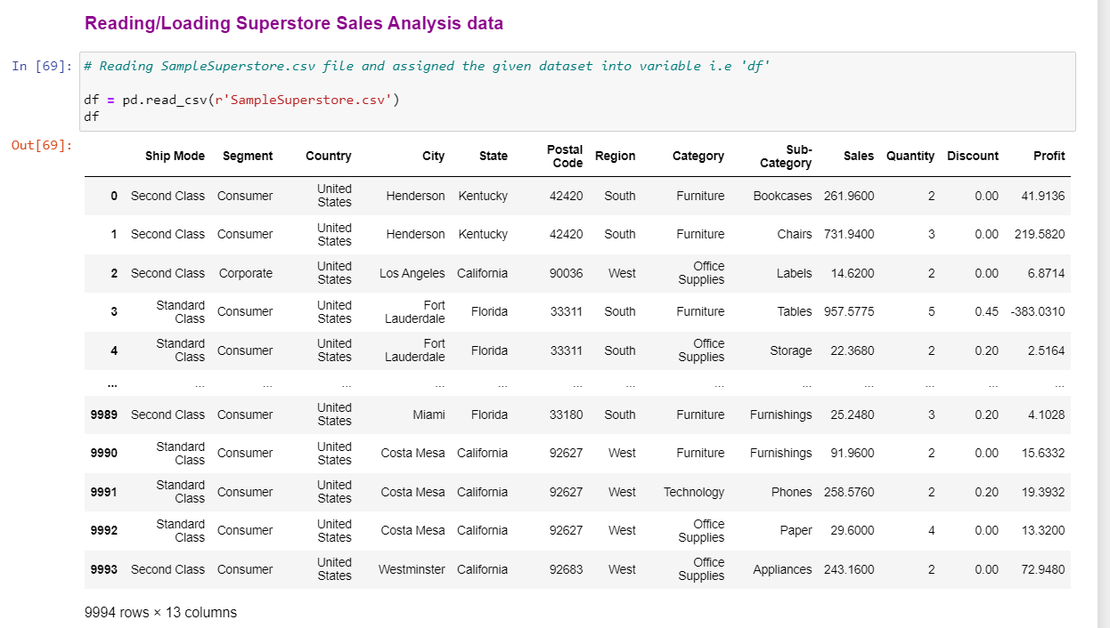
About the Data
Dataset: Superstore Sales Dataset
Below is dataset of Superstore Sales Analysis.
Raw dataset having 9994 rows & 13 columns.
@InnoByte Service

Slide 7
Proposed Solution
In given dataset, we have many features like ship mode, Segment, country, City, State, Postal code, Region, category, sub-category, sales, Quantity, discount, and profit. So, from given dataset we can analyze our data into different areas:
Descriptive Statistics
Customer Segmentation
Product Analysis
Order Analysis
@InnoByte Service

Slide 8
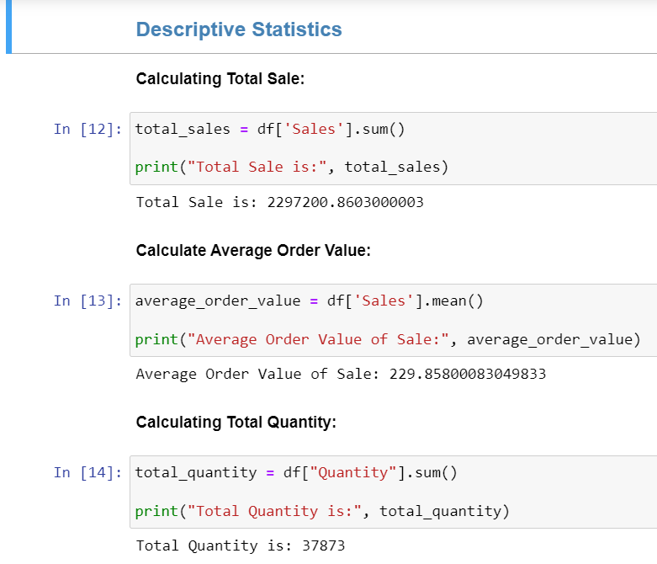
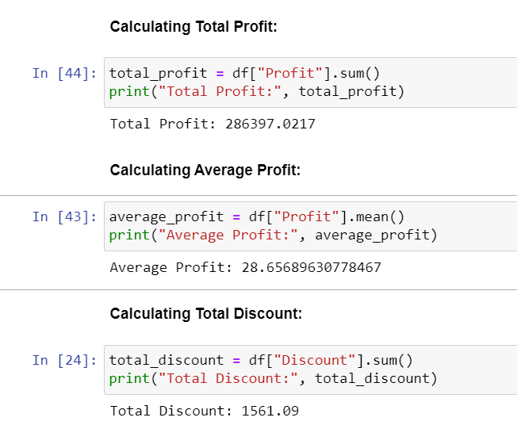
Descriptive Statistics
In Descriptive statistics we have calculated total_sale, average_orders, total_quantity, total_profit, average_profit & total_discounts of our data.
@InnoByte Service

Slide 9
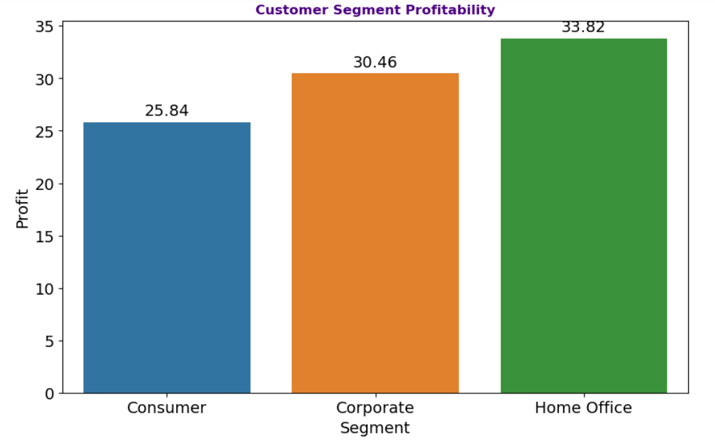
Customer Segmentation
Most Profitable Customer Segment: From below graph we can say that most profitable customer segment is "Home Office"
@InnoByte Service

Slide 10
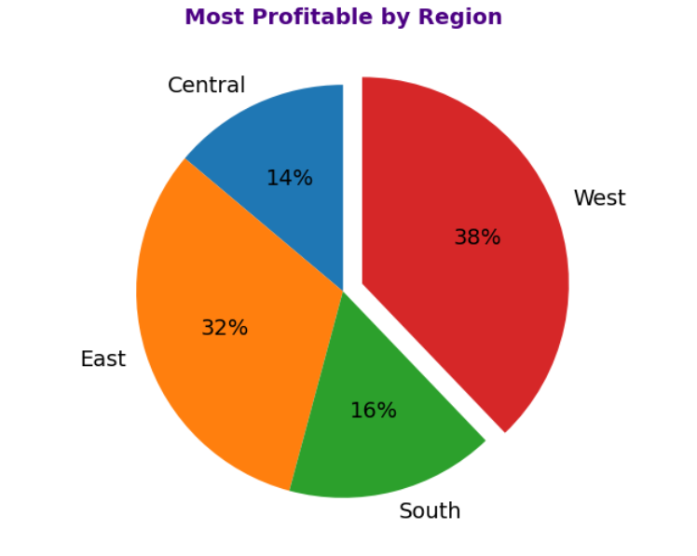
Customer Segmentation
Most Profitable Customer Region: From below graph we can say that most profitable customer region is “West“.
@InnoByte Service

Slide 11
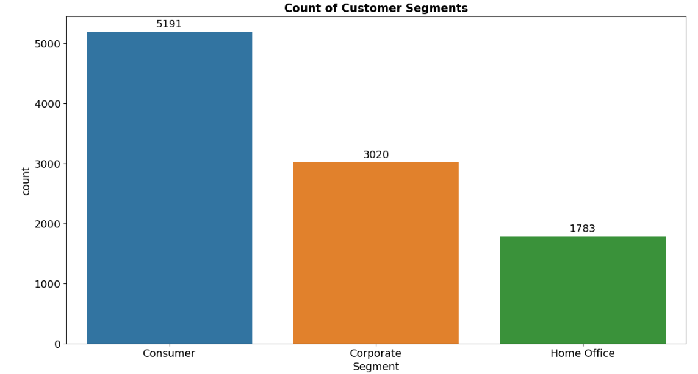
Customer Segmentation
Count of Customer Segment: From below graph we can say that in “Consumer” segment count is very high. But here we observe count of "Home Office" segment is very low. So improvement is need in this segment.
@InnoByte Service

Slide 12
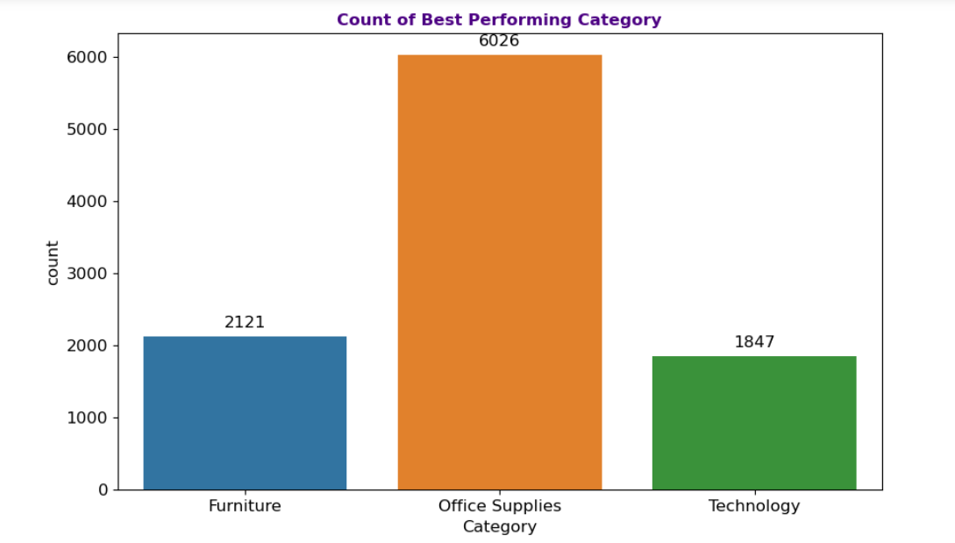
Product Analysis
Best Performing Category: From below graph we can observe that best performing category is "Office Supplies".
@InnoByte Service

Slide 13
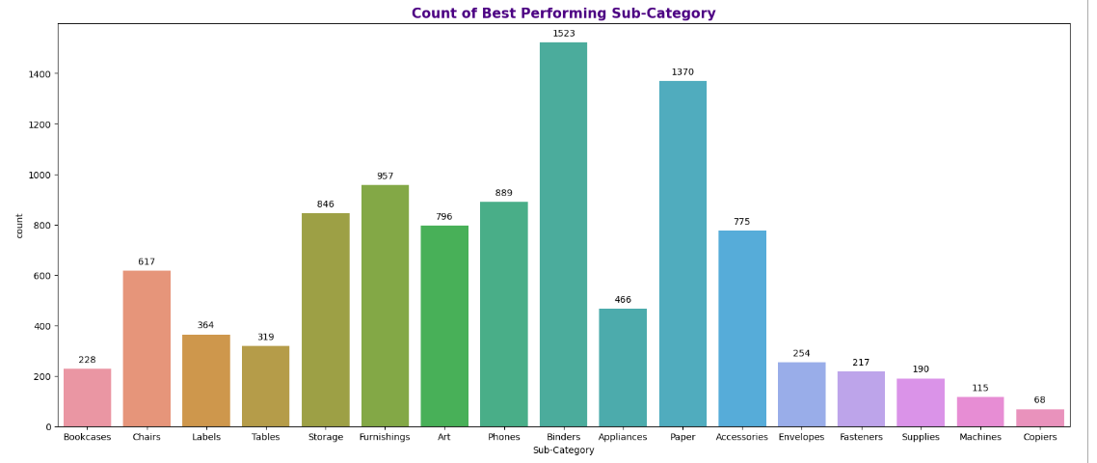
Product Analysis
Best Performing Sub-Category: From below graph we can observe that best performing sub-category is “Binders". "Machines" and "Copiers" has very low count. Improvement is needed in these two Sub-Category
@InnoByte Service

Slide 14
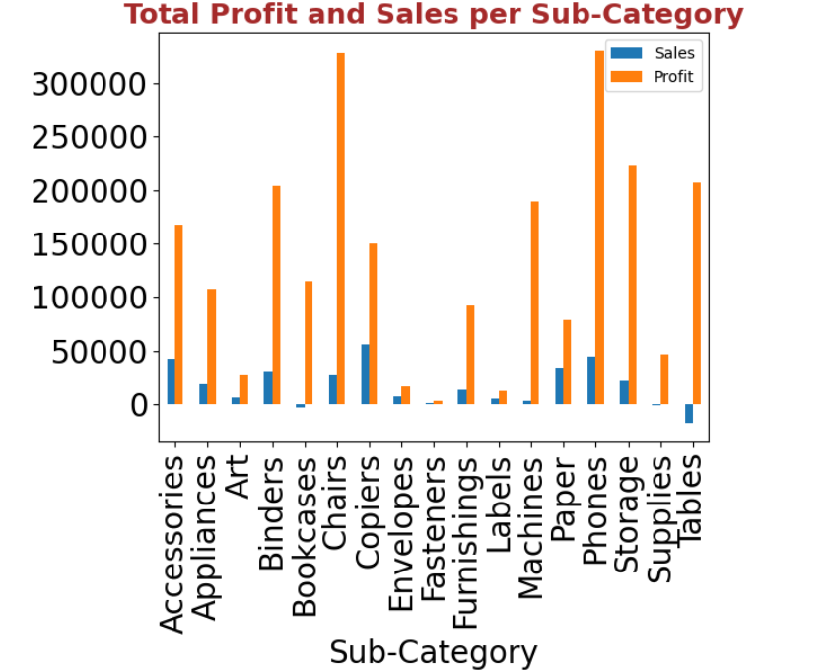
Product Analysis
Total Profit and Sales per Sub-Category: From graph we can say that Highest profit is earned in Chairs & Phones while Selling price for Copiers is extremely high compared to other products.
@InnoByte Service

Slide 15
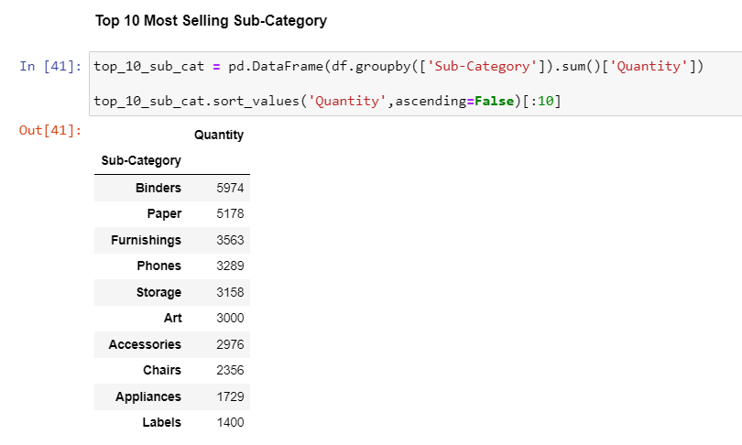
Product Analysis
Top 10 Most Selling Sub-Category: Below are top 10 most selling sub-category.
@InnoByte Service

Slide 16
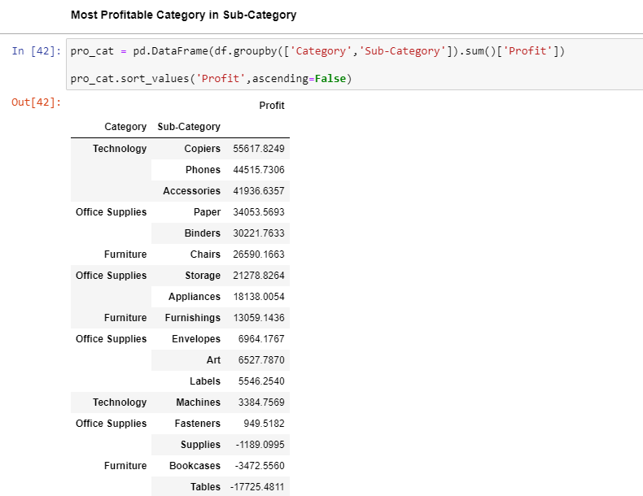
Product Analysis
Most Profitable Category in Sub-Category: Below are most profitable category in sub-category.
@InnoByte Service

Slide 17
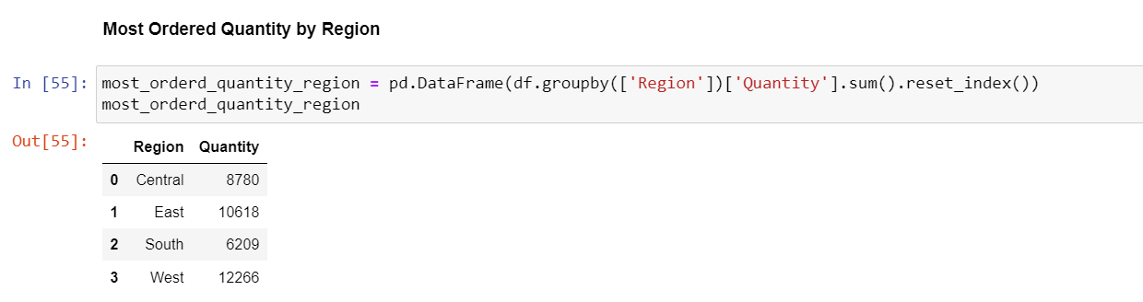
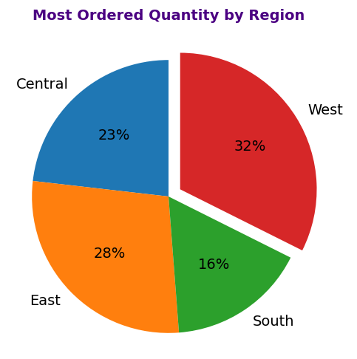
Order Analysis
Most Ordered Quantity by Region: Below is the most ordered quantity of product by region. In “West” region most of the product are sold.
@InnoByte Service

Slide 18
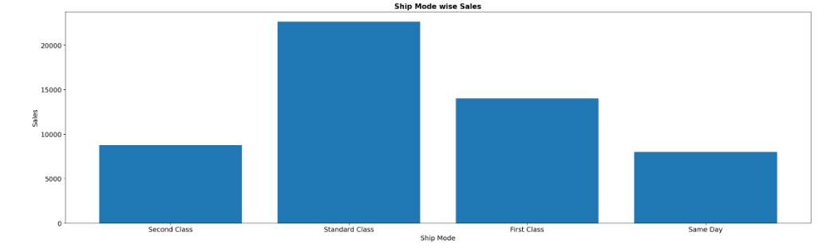
Order Analysis
Sales by Ship Mode: Below graph shows that the sales are high if the ship mode is standard class, and sales are low if the ship mode is either second class or same day. Most of the orders are placed using Standard class shipment mode
@InnoByte Service

Slide 19
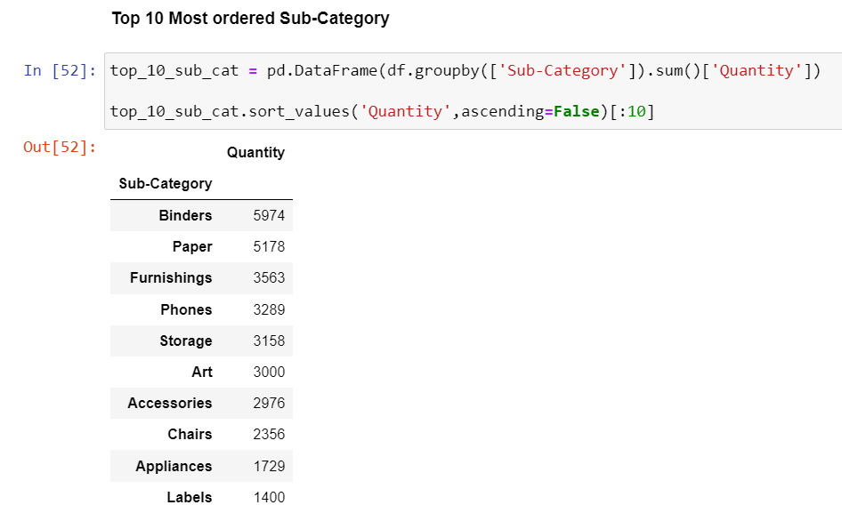
Order Analysis
Top 10 Most Ordered Sub-Category: Below are top 10 ordered Sub-Category.
@InnoByte Service

Slide 20
Insights
Most profitable Customer Segment is “Home-Office” which generated 33% of profit.
Most profitable Customer Region is “West” which gives highest profit i.e., 38% from other regions.
In “Consumer” segment count is very high. But here we observe count of "Home Office" segment is very low. So improvement is need in this segment.
From product category best performing category is "Office Supplies“ and best performing sub-category is “Binders“.
In sub-category Highest Profit is earned by “Chairs & Phones” while Selling Price for “Copiers” is extremely high compared to other products.
The most ordered quantity of product order in “West” region.
Most of the orders are placed using Standard class shipment mode.
@InnoByte Service

Slide 21
Conclusion
Superstore Data Analysis journey has given us a closer look at how the business is doing. We started by digging into the dataset, making sure it’s clean and ready for analysis. Then, we explored different aspects like what people buy, how much they spend, and what regions contribute the most. We have learned how to perform Exploratory Data Analysis. We have visualized and analyzed various use cases in the superstore dataset. We got some insightful results about the Profit and Sales that can be used to improve future policies.
@InnoByte Service

